Slide 1
Volume of cylinders
Perimeter, area and volume

Slide 2
how to use Oak lessons

Slide 3
I can use the constant cross-sectional area property of cylinders to determine their volume.

Slide 4
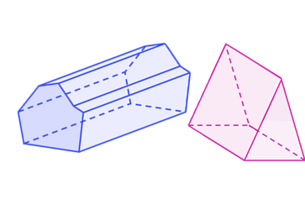
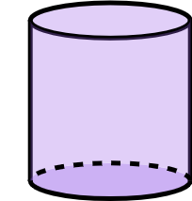
A prism is a polyhedron with a base that is a polygon and a parallel opposite face that is identical. The corresponding edges of the two polygons are joined by parallelograms.
The radius is any line segment that joins the centre of a circle to its circumference.
A cylinder is a 3D shape with a base that is a circle and a parallel opposite face that is identical. A cross section of a cylinder made parallel to the base will be congruent to the base.

Slide 5

Volume of cylinders
Calculating the volume of a cylinder
Using the volume of a cylinder

Slide 6

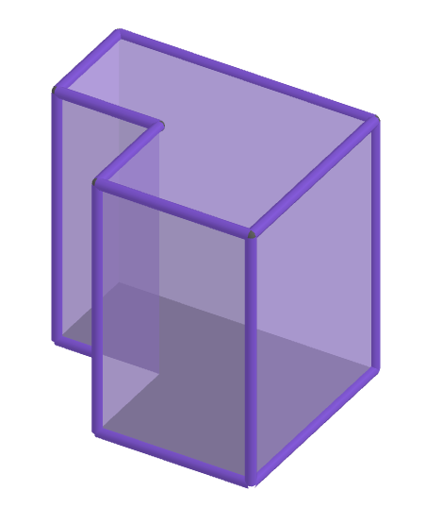
Calculating the volume of a cylinder
What is the same and what is different about a cylinder and a prism?
Properties which are the same:
3D shape
uniform cross-section through length

Slide 7
Calculating the volume of a cylinder
What is the same and what is different about a cylinder and a prism?
Properties which are different:
Cross-sectional face is a circle on a cylinder which is not a polygon

Slide 8
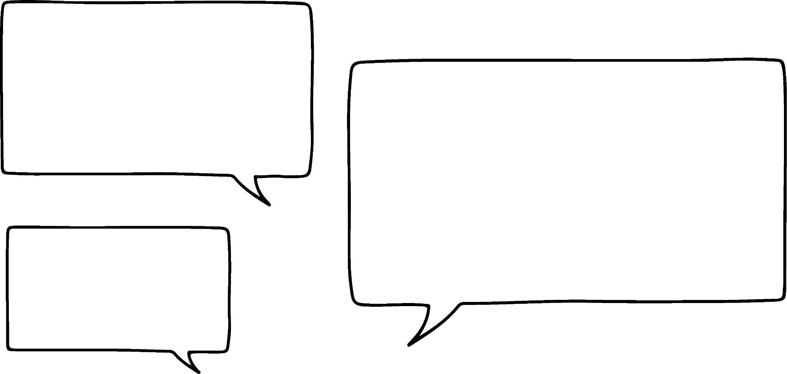
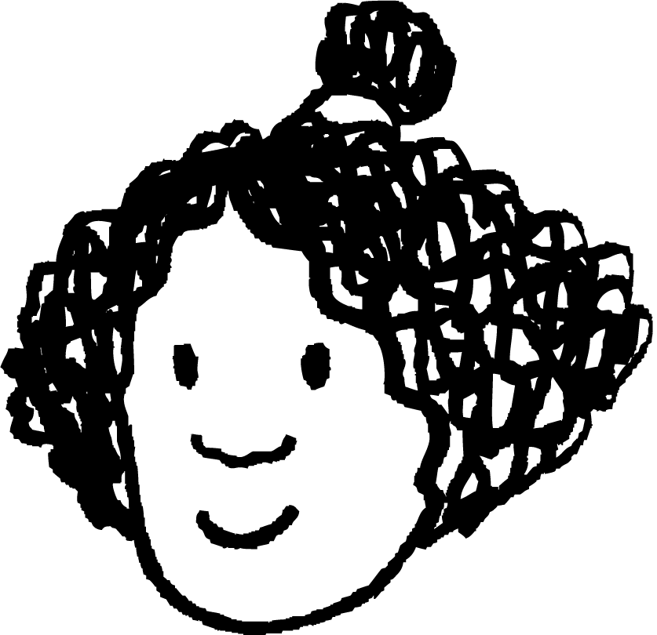
Calculating the volume of a cylinder
What is the same and what is different about a cylinder and a prism?
A cylinder is not a prism but has a very similar structure.
Izzy

Slide 9

Calculating the volume of a cylinder
A cylinder is a prism.
A prism has a uniform polygonal cross-section.
A prism has a uniform cross-section.

Slide 10

Calculating the volume of a cylinder
We can work out the volume in a similar way to a prism.
As it is like a stack of circle slices.
Izzy
height
Aisha

Slide 11
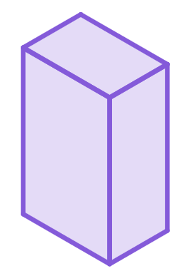
Calculating the volume of a cylinder
Volume is the space inside of a 3D solid.
It is calculated by multiplying three perpendicular lengths.
Volume of any prism = area of cross-section × length
= (length × length) × length
Units of volume can be cm³ or mm³ or m³ .
Can you think of any others?
ft³
in³

Slide 12

Calculating the volume of a cylinder
Circular cross-section
r cm
r cm
height
Area = 𝜋r²
Volume of a cylinder = 𝜋r² × height

Slide 13

Calculating the volume of a cylinder
Volume of a cylinder = 𝜋r²h
where r is the radius and h is the height
r cm
Because of order of operations you must square the radius before anything else.
h cm
Lucas

Slide 14
Calculating the volume of a cylinder
Volume of a cylinder = 𝜋r²h
where r is the radius and h is the height
V = 𝜋 × 4² × 9
= 𝜋 × 16 × 9
= 144𝜋 cm³
= 452 cm³ (3 s.f.)
4 cm
9 cm

Slide 15

Calculating the volume of a cylinder
Identify the errors in this solution.
Volume = 𝜋 × (5 × 12)² = 3600𝜋 cm²
5 cm
12 cm
Only the radius (5) should be squared.
The units should be cm³.
Therefore the answer is wrong too.

Slide 16


Calculating the volume of a cylinder
Sofia sees some packaging at the shop that is this shape.
plan view
side view
Sofia
She describes it as a cylinder with a narrower cylinder removed.
Calculate the area of the cross-section, then multiply it by the height.
Is there a way to calculate the volume of this?
Alex

Slide 17

Calculating the volume of a cylinder
Sofia sees some packaging at the shop that is this shape.
plan view
side view
Sofia
She describes it as a cylinder with a narrower cylinder removed.
Subtract the volume of the centre cylinder from the volume of the larger cylinder.
Is there a way to calculate the volume of this?
Sam

Slide 18
Calculating the volume of a cylinder
26 cm
plan view
side view
8 cm
6 cm
6 cm
26 cm
Sam
8 cm
Alex
Volume of large cylinder =
𝜋 × 13² × 6 = 1014𝜋 cm³
Volume of inner cylinder =
𝜋 × 8² × 6 = 384𝜋 cm³
Volume = 1014𝜋 - 384𝜋
= 630𝜋 cm³
Cross-sectional area:
𝜋 × 13² - 𝜋 × 8² = 105𝜋 cm²
Volume = 105𝜋 × 6 = 630𝜋 cm³

Slide 19
Calculating the volume of a cylinder
A necklace pendant is cylindrical. Its cross-section is shown here. It is 3 mm deep. Which calculation would work out the volume of the pendant?
4 mm
(𝜋 × 32² - 𝜋 × 4²) × 3
𝜋 × 32² × 3 - 𝜋 × 4² × 3
32 mm
(𝜋 × 16² - 𝜋 × 2²) × 3
𝜋 × 16² × 3 - 𝜋 × 4² × 3

Slide 20

Calculating the volume of a cylinder
1) This is the formula for the volume of a cylinder = 𝜋r²h, where r is the radius and h is the height. Which of the following are equivalent?
a
V = (𝜋r)²h
e
V = 𝜋 × r × r × h
V = 𝜋hr²
V = 𝜋 × h × r × r
b
f
c
V = 𝜋rh²
g
V = 𝜋²rh
d
V = 𝜋(rh)²
h
V = r²h𝜋

Slide 21

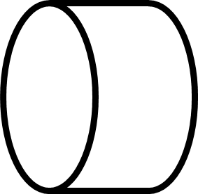
Calculating the volume of a cylinder
2) Calculate the volume of the following cylinders. Leave in terms of 𝜋.
2 m
3.5 cm
a)
3 cm
b)
c)
42 mm
7 cm
4 m
d) A cylinder with a radius of 8 mm and a depth of 12 mm
e) A cylinder with a diameter of 4.8 cm and a height of 12 cm

Slide 22

Calculating the volume of a cylinder
3) A metal washer factory forms a long metal pipe before slicing them into individual washers. What volume of metal is used to create this section of pipe?
length = 360 mm
internal diameter = 12 mm
external diameter = 35 mm

Slide 23
Calculating the volume of a cylinder
1) This is the formula for the volume of a cylinder = 𝜋r²h, where r is the radius and h is the height. Which of the following are equivalent?
a
V = (𝜋r)²h
e
V = 𝜋 × r × r × h
V = 𝜋hr²
V = 𝜋 × h × r × r
b
f
c
V = 𝜋rh²
g
V = 𝜋²rh
d
V = 𝜋(rh)²
h
V = r²h𝜋

Slide 24
Calculating the volume of a cylinder
2) Calculate the volume of the following cylinders. Leave in terms of 𝜋.
2 m
3.5 cm
a)
3 cm
b)
c)
42 mm
7 cm
4 m
V = 61 740𝜋 mm³
V = 61.74𝜋 cm³
V = 63𝜋 cm³
V = 4𝜋 m³
d) A cylinder with a radius of 8 mm and a depth of 12 mm
V = 768𝜋 mm³
e) A cylinder with a diameter of 4.8 cm and a height of 12 cm
V = 69.12𝜋 cm³

Slide 25
Calculating the volume of a cylinder
3) A metal washer factory forms a long metal pipe before slicing them into individual washers. What volume of metal is used to create this section of pipe?
Calculating in mm
V = (𝜋 × 17.5² - 𝜋 × 6²) × 360
V = 97 290𝜋 mm³ = 305 645.5 mm³
Calculating in cm
length = 360 mm
V = (𝜋 × 1.75² - 𝜋 × 0.6²) × 36
V = 97.29𝜋 cm³ = 305.6 cm³
internal diameter = 12 mm
external diameter = 35 mm

Slide 26
Volume of cylinders
Calculating the volume of a cylinder
Using the volume of a cylinder

Slide 27

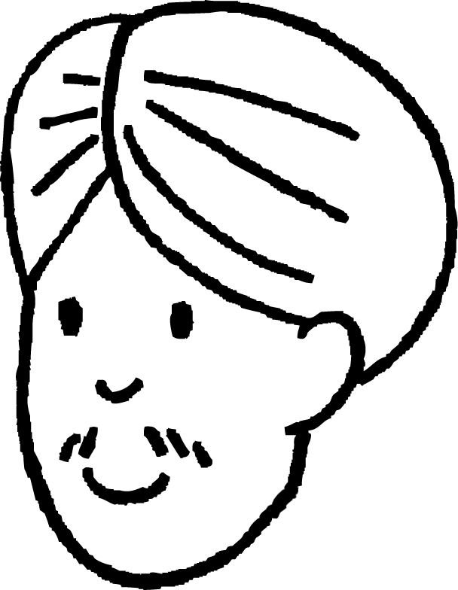
Using the volume of a cylinder
The formula for the volume of a cylinder has 3 variables; volume, radius and height.
9 cm
Volume
= 1215𝜋 cm³
If you have two of the three variables, you can work out the third.
h cm
Volume = 𝜋r²h
1215𝜋 = 𝜋 × 9² × h
1215𝜋 = 81𝜋 × h
Andeep
h = 15

Slide 28
Using the volume of a cylinder
Work out the height of a cylinder, with a volume of 225𝜋 cm³ and a diameter of 10 cm.
Work out the height of a cylinder, with a volume of 448𝜋 cm³ and a diameter of 16 cm.
d = 10 cm → r = 5 cm
d = 16 cm → r = 8 cm
Volume = 𝜋r²h
Volume = 𝜋r²h
225𝜋 = 𝜋 × 5² × h
448𝜋 = 𝜋 × 8² × h
225𝜋 = 25𝜋 × h
448𝜋 = 64𝜋 × h
9 = h
7 = h
height is 9 cm
height is 7 cm

Slide 29
Using the volume of a cylinder
The formula for the volume of a cylinder has 3 variables; volume, radius and height.
?
Volume
= 768𝜋 cm³
Area =
If you have two of the three variables, you can work out the third.
12 cm
Volume = 𝜋r²h
= area of circle × height
768𝜋 = 𝜋r² × 12
If you know the area of the circle, what other information can you work out?
Andeep
𝜋r² = 64𝜋 cm²

Slide 30
Using the volume of a cylinder
The formula for the volume of a cylinder has 3 variables; volume, radius and height.
r cm
Volume
= 768𝜋 cm³
area
→ the radius
12 cm
Volume = 𝜋r²h
768𝜋 = 𝜋r² × 12
𝜋r² = 64𝜋
r² = 64
Andeep
r = 8

Slide 31
Using the volume of a cylinder
The formula for volume of a cylinder has 3 variables; volume, radius and height.
d cm
Volume
= 768𝜋 cm³
area
→ the radius
→ the diameter
12 cm
Volume = 𝜋r²h
768𝜋 = 𝜋r² × 12
𝜋r² = 64𝜋
r² = 64
Andeep
r = 8 →
d = 16

Slide 32
Using the volume of a cylinder
Given that the radius of the cylinder is 6 cm, which of the following are true?
The height of the cylinder is 12 cm.
The diameter of the cylinder is 12 cm.
The volume of the cylinder is 36𝜋 cm³.
The area of the cross-section is 36𝜋 cm².

Slide 33

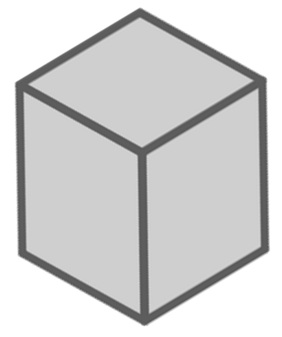
Using the volume of a cylinder
Laura is buying a candle and gift box for her Grandma.
The candle is cylindrical. It has a volume of 256𝜋 cm³ and is 16 cm tall.
The box is 75 mm × 75 mm × 165 mm. Will the candle fit?
It doesn’t fit.
Alex
The candle is shorter than the box, so it will fit by height.
7.5 cm
7.5 cm
16.5 cm
The volume of the cylinder is 804.2 cm³ (1 d.p.) and the box is 7.5 × 7.5 × 16.5 = 928.1 cm³ (1 d.p.), so it has less volume.
So why doesn’t it fit?

Slide 34
Using the volume of a cylinder
Laura is buying a candle and gift box for her Grandma.
The candle is cylindrical. It has a volume of 256𝜋 cm³ and is 16 cm tall.
The box is 75 mm × 75 mm × 165 mm. Will the candle fit?
It doesn’t fit.
Alex
The circular face of the cylinder needs to fit within the square face of the box.
7.5 cm
7.5 cm
Volume = 𝜋r²h
16.5 cm
256𝜋 = 𝜋r² × 16
As 8 cm > 7.5 cm, the candle will not fit in the box.
16 = r²
r = 4 → d = 8

Slide 35
Using the volume of a cylinder
A box is being made for a cylindrical sculpture. The cylinder has a volume of 11 250𝜋 cm³ and a height of 50 cm. What is the smallest the box can be, so the sculpture fits?
11 250𝜋 = 𝜋r² × 50
225 = r²
The box needs to be at least 30 cm x 30 cm x 50 cm,
to fit the sculpture.
15 = r
d = 30

Slide 36





Using the volume of a cylinder
1) All of these cylinders have the same volume. Calculate the missing lengths.
40 cm
c cm
b cm
a cm
8 cm
40 cm
6 cm
e cm
10 cm
d cm
2 cm
3.6 m

Slide 37
Using the volume of a cylinder
1) All of these cylinders have the same volume. Calculate the missing lengths.
40 cm
22.5 cm
Volume = 360𝜋 cm³
0.9 cm
3 cm
8 cm
40 cm
6 cm
90 cm
10 cm
2 cm
2 cm
3.6 m

Slide 38
Volume of cylinders
Cylinders have a similar structure to prisms.
The formula for finding the volume of a cylinder is 𝜋r²h, where r is the radius and h is the height.
The formula can be used to find the radius, diameter or height if you know the volume.

Slide 39

© Oak National Academy 2023.
Produced in partnership with Mathematics in Education and Industry.
Licensed on the Open Government Licence v3.0, except where otherwise stated. See Oak terms and conditions.

